Slide 1
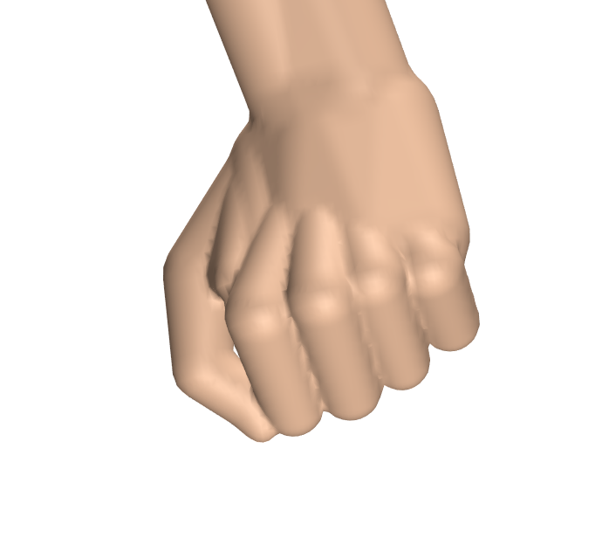
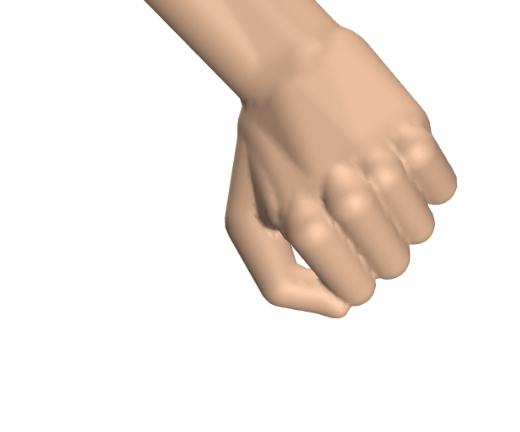
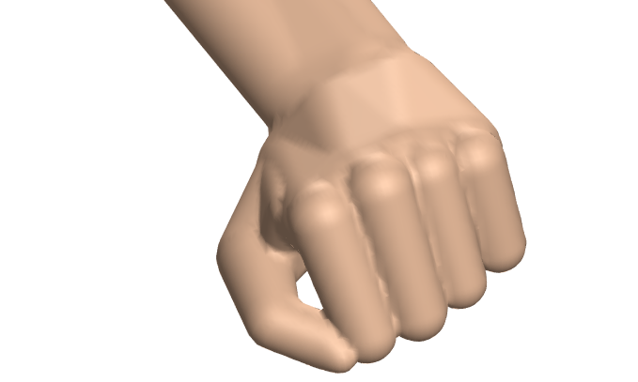
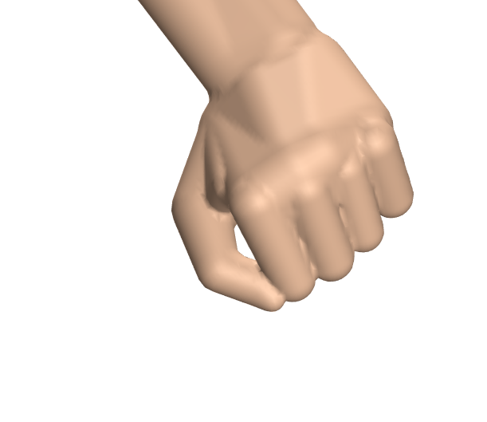
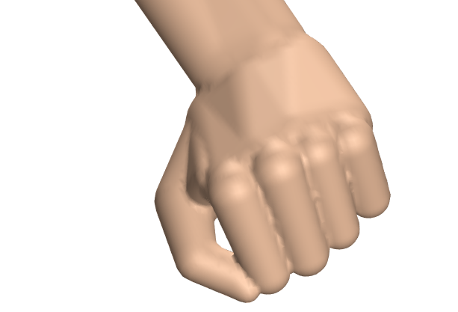
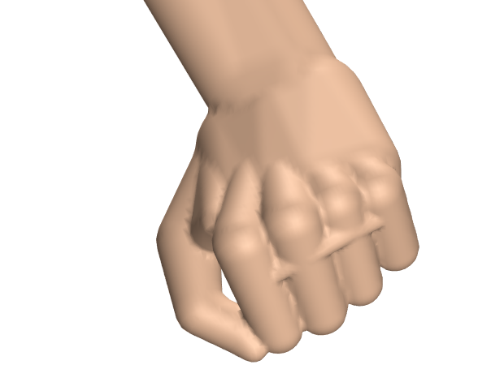
tangency = 1 smoothness = 0.3
tangency = 3 smoothness = 0.3
tangency = 5 smoothness = 0.3
tangency = 10 smoothness = 0.3
tangency = 5 smoothness = 1
It looks like that tradeoff is extremely subtle, which is not good
tangency = 5 smoothness = 3

